Slide 1
The environment of CIG96
{
Faint features in isolated galaxies
Pablo Ramírez Moreta (PhD student at IAA-CSIC)
Advisors: Lourdes Verdes Montenegro (IAA-CSIC)
Stéphane Leon (ESO/JAO)
ESO 7nov2014

Slide 2
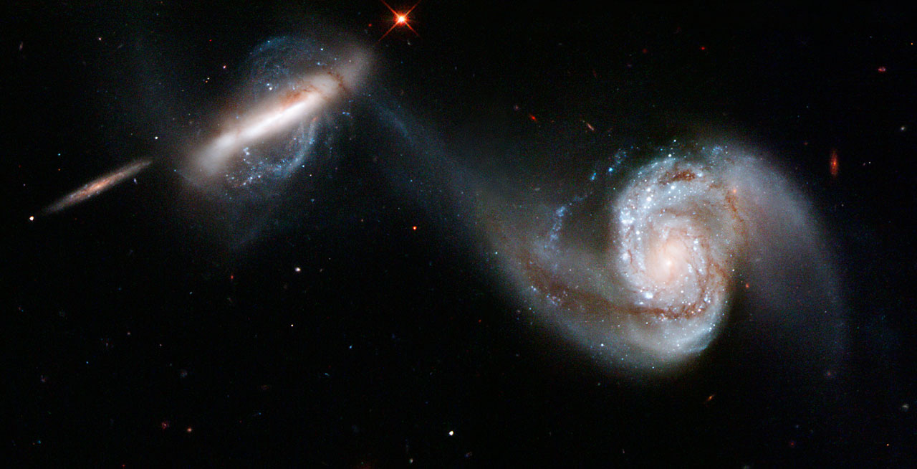
motivation
galaxies evolution α f (interactions & mergers)
internal evolution VS external interactions
NGC 3808 / Arp 87 HST

Slide 3
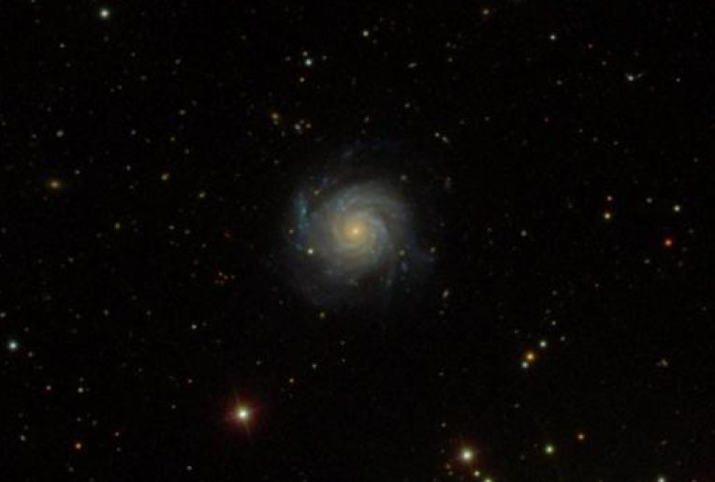
motivation
galaxies evolution α f (interactions & mergers)
internal evolution VS external interactions
Isolated galaxy
NGC 2776 / CIG314 SDSS

Slide 4
motivation
galaxies evolution α f (interactions & mergers)
internal evolution VS external interactions
Considering isolated galaxies:
Can secular evolution processes lead to asymmetries?
NGC 2776 / CIG314 SDSS

Slide 5
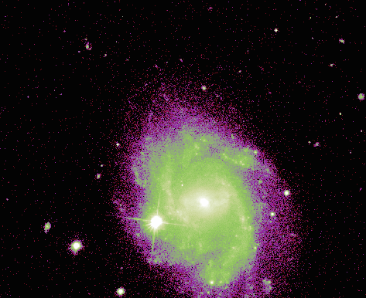
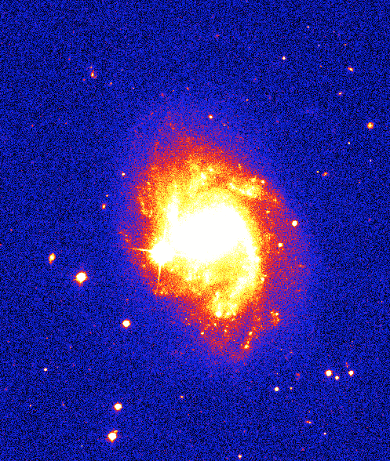
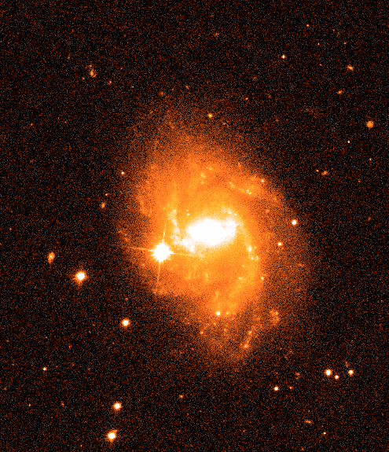
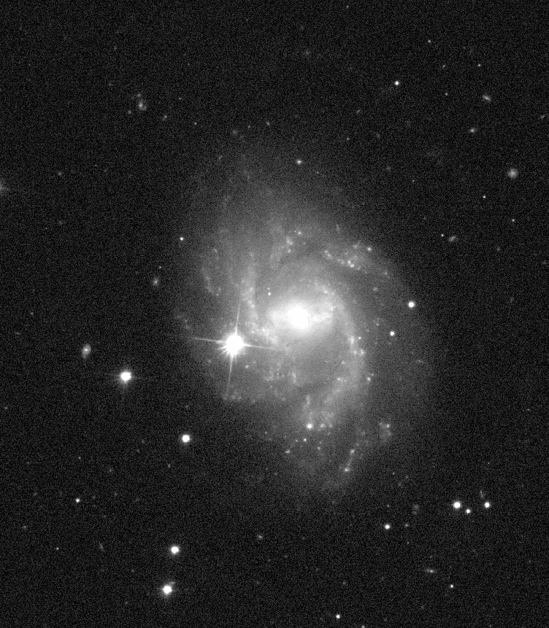
description
large sample
multi-λ study
isolated galaxies
Catalogue of
Isolated
Galaxies
DEC
frequency
RA
Karatchenseva+ 73
isolation criteria?
CIG96 SDSS
AMIGA
Analysis of the interstellar Medium of Isolated GAlaxies

Slide 6
isolation
POSS I+II R ≥ 0.5 Mpc
m_{B} < 17.5 mag V > 1500 km/s
η_{K}
Q
Local number density:
Tidal strength estimation:
Q_{ip} = F_{tidal} / F_{bind}
Q = log(Σ_{i} Q_{ip})
η_{K} α log [ k -1 / V(r_{k}) ]
distance
size/mass
size/mass
Verley PhD
Verley+ 07ab
Argudo-Fernández+ 13

Slide 7
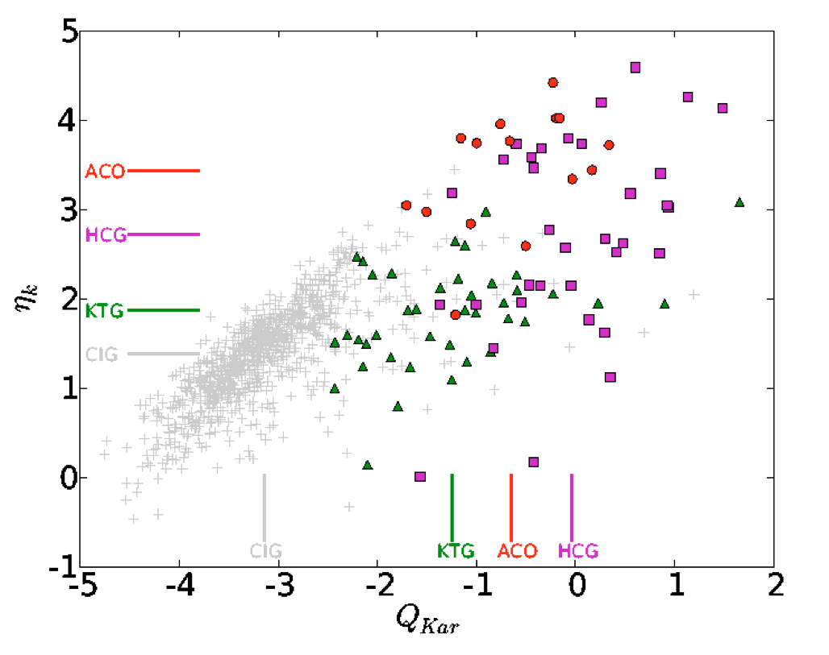
isolation
Local number density: η_{K}
Tidal strength estimation: Q_{kar}
Verley+ 07b

Slide 8
faint features
…despite being highly isolated galaxies, asymmetries EXIST

Slide 9
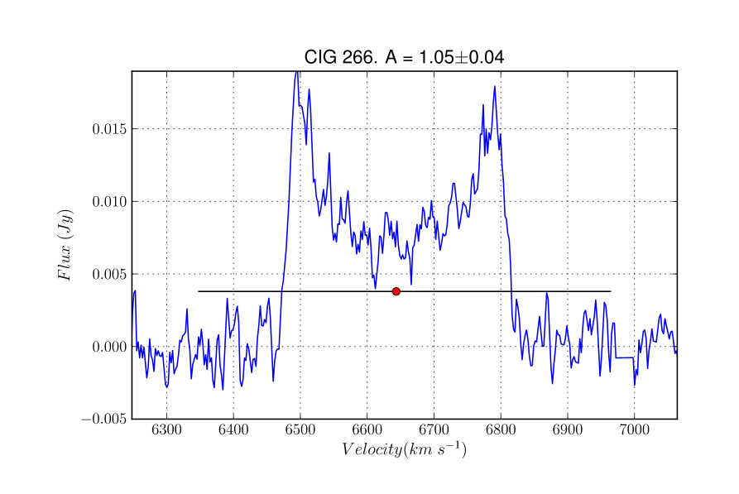
faint features
…despite being highly isolated galaxies, asymmetries EXIST
Espada+ 05, 11

Slide 10
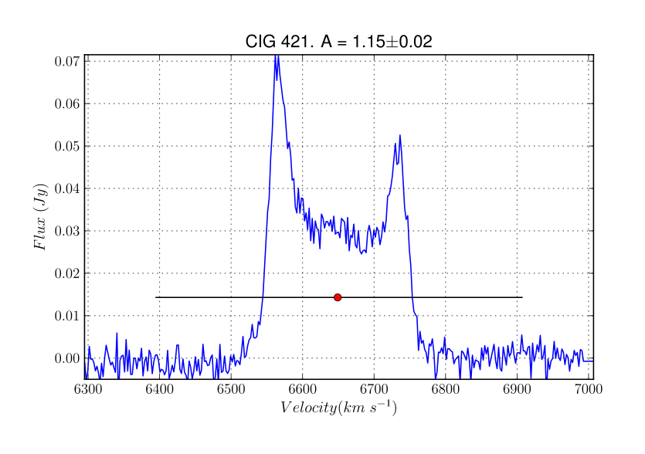
faint features
…despite being highly isolated galaxies, asymmetries EXIST
Espada+ 05, 11

Slide 11
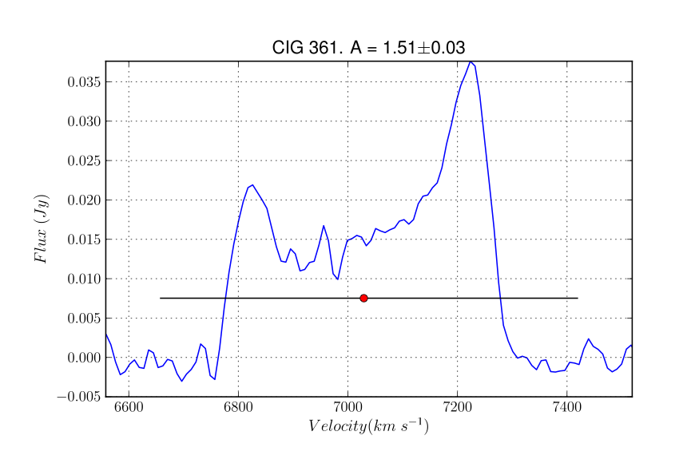
faint features
…despite being highly isolated galaxies, asymmetries EXIST
Espada+ 05, 11

Slide 12
faint features
…despite being highly isolated galaxies, asymmetries EXIST
Does this imply that secular evolution processes can lead to asymmetries?
Espada+ 05, 11

Slide 13
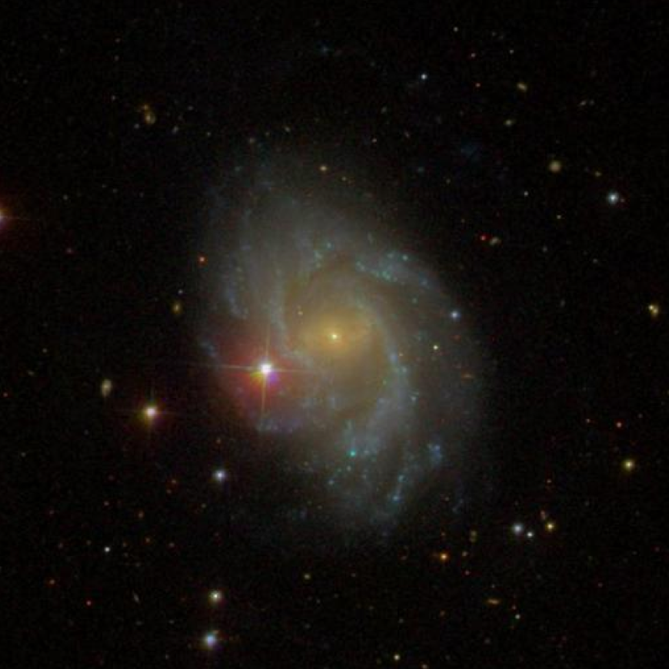
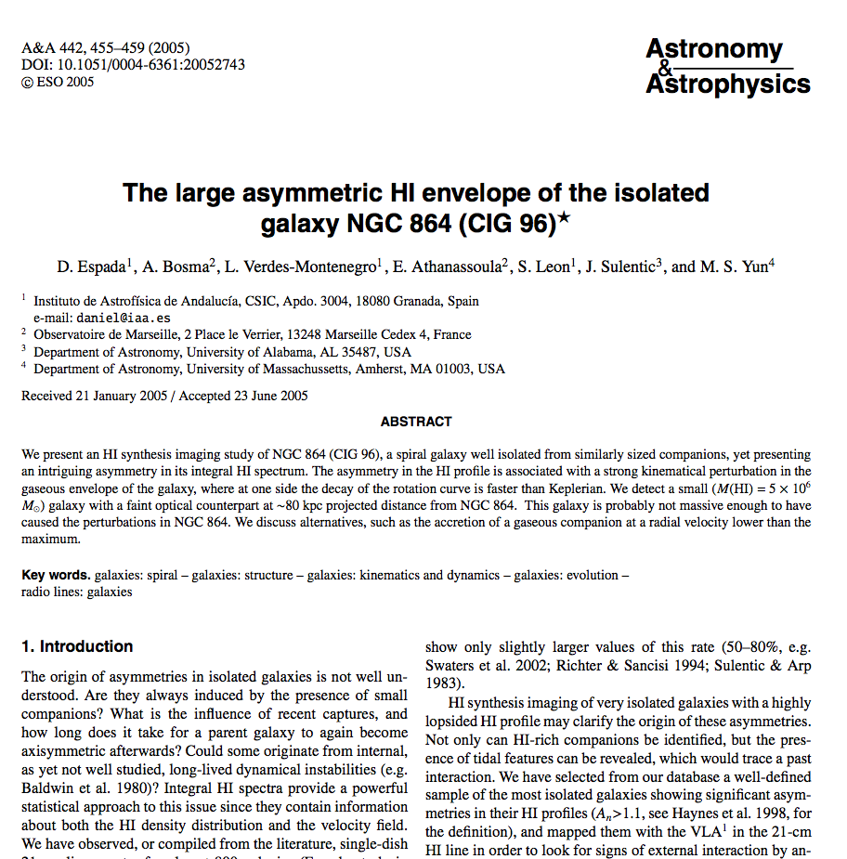
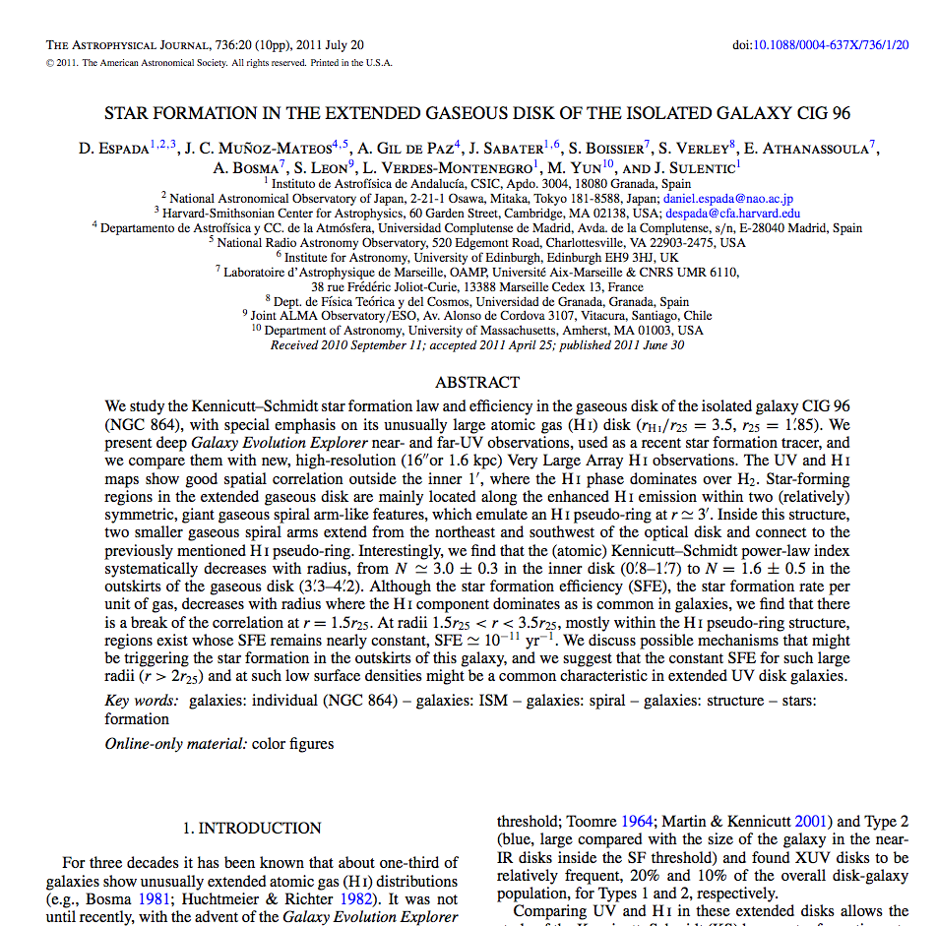
faint features
CIG96
Deep observations in HI and optical
SBc
1561 km/s (z ~ 0.0052)
very extended arms ~ ring shaped
Espada+ 05, 11

Slide 14
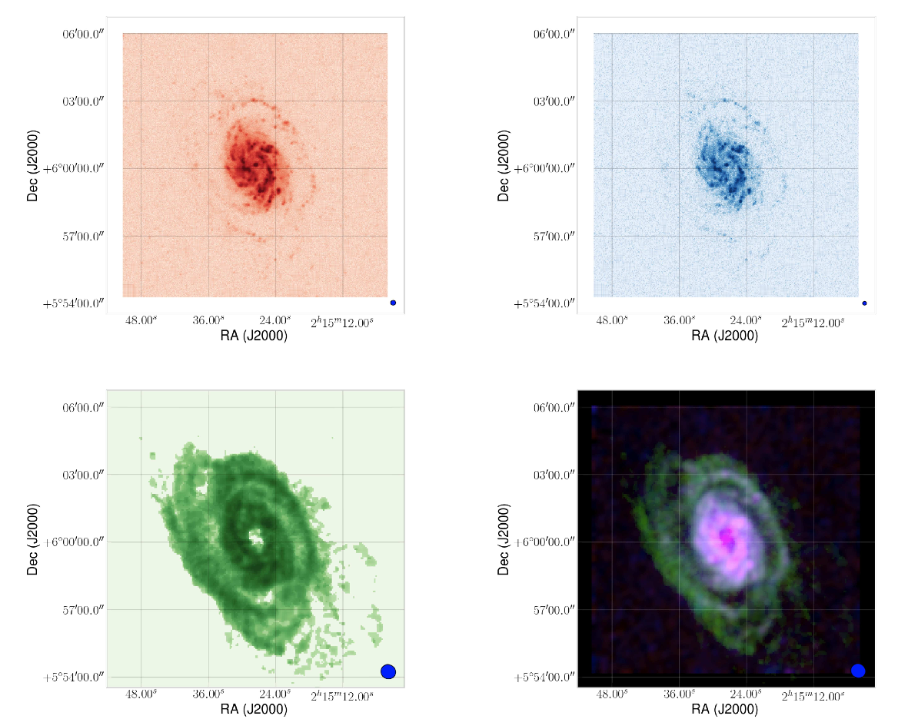
faint features
CIG96
UV + VLA data: 4h C+D
Espada+ 11
NUV FUV
VLA Sup.

Slide 15
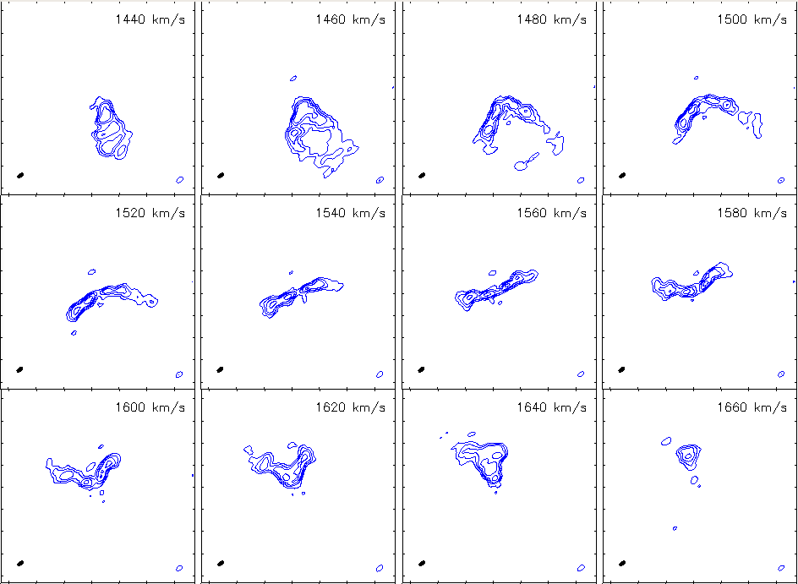
faint features
CIG96
EVLA data: 10h x C + 2h x D

Slide 16
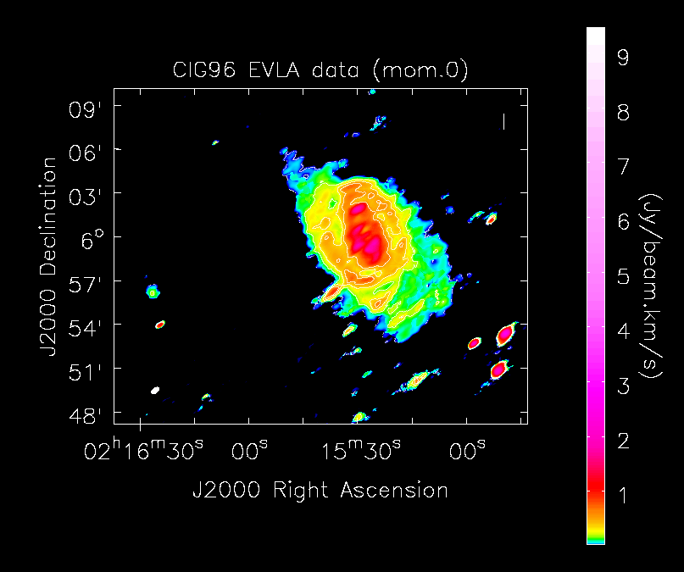
faint features
CIG96
EVLA data: 10h x C + 2h x D
Integrated flux (moment 0)
Resolution:
37.57 x 19.97 arcsec²
rms ~ 0.5 mJy
N(HI)_{3σ} = 7.5×10¹⁹ at/cm²

Slide 17
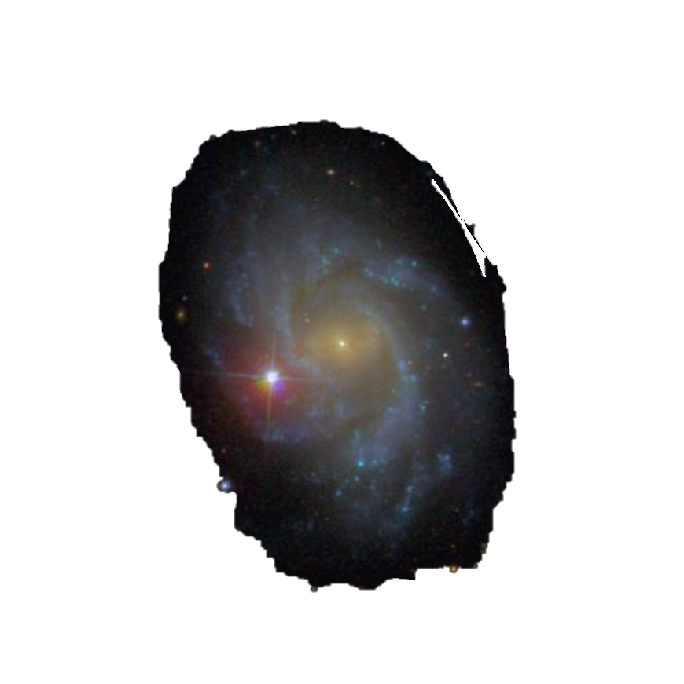
faint features
CIG96
EVLA data: 10h x C + 2h x D
Integrated flux (moment 0)
+ optical
Resolution:
37.57 x 19.97 arcsec²
rms ~ 0.5 mJy
N(HI)_{3σ} = 7.5×10¹⁹ at/cm²

Slide 18
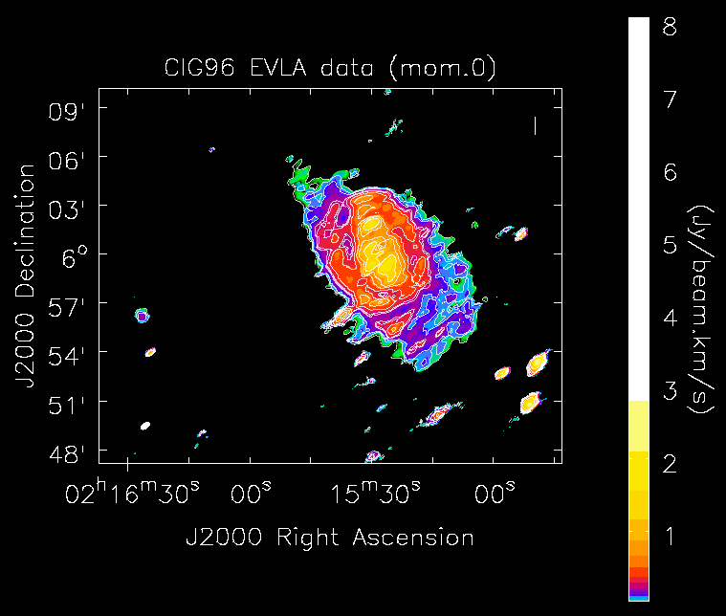
faint features
CIG96
EVLA data: 10h x C + 2h x D
Integrated flux (moment 0)
Resolution:
37.57 x 19.97 arcsec²
rms ~ 0.5 mJy
N(HI)_{3σ} = 7.5×10¹⁹ at/cm²

Slide 19
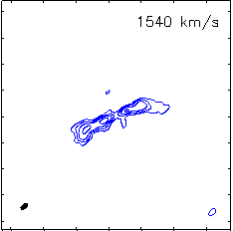
faint features
CIG96
EVLA data: 10h x C + 2h x D
Integrated flux (moment 0)
Resolution:
37.57 x 19.97 arcsec²
rms ~ 0.5 mJy
N(HI)_{3σ} = 7.5×10¹⁹ at/cm²

Slide 20
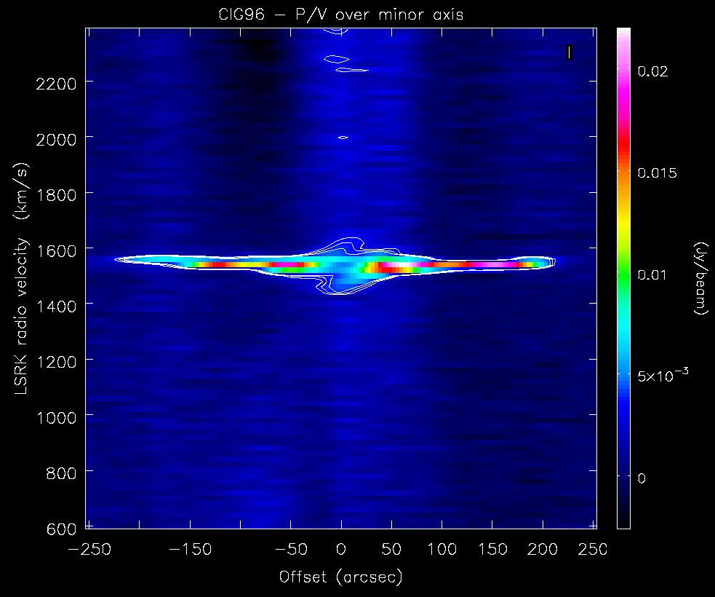
faint features
CIG96
EVLA data: 10h x C + 2h x D
Position-velocity profile
(minor axis, PA = -65 deg)
6σ – 8σ contours
Traces of possible:
extraplanar movements?
streaming motions inside the disk?
external accretion?
(TBC yet)

Slide 21
faint features
CIG96
EVLA data: 10h x C + 2h x D
Integrated emission (moment 0)
Resolution:
37.57 x 19.97 arcsec²
rms ~ 0.5 mJy
N(HI)_{3σ} = 7.5×10¹⁹ at/cm²

Slide 22
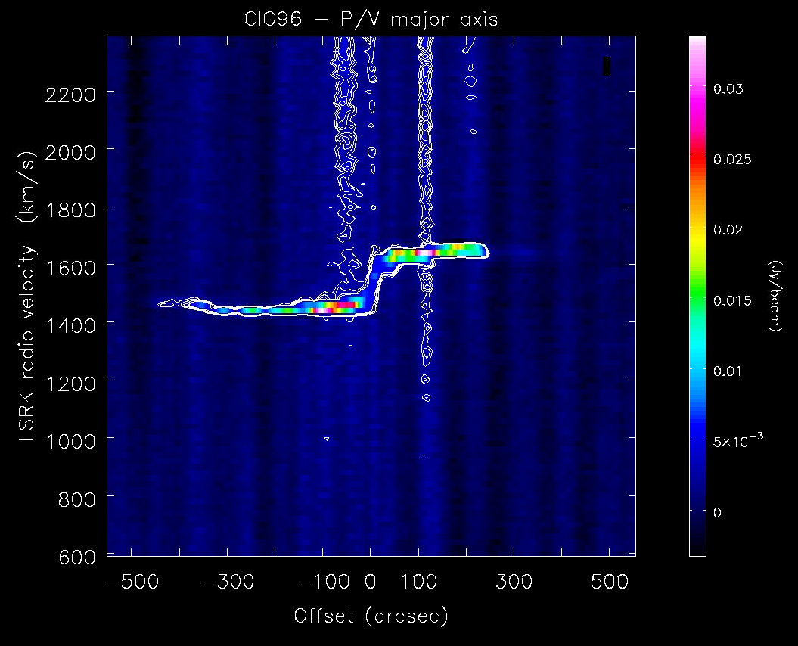
faint features
CIG96
EVLA data: 10h x C + 2h x D
Position-velocity profile
(major axis, PA = 23 deg)
Noticeable decrease in velocity in the approaching part of CIG96 (SW region)
NE
SW

Slide 23
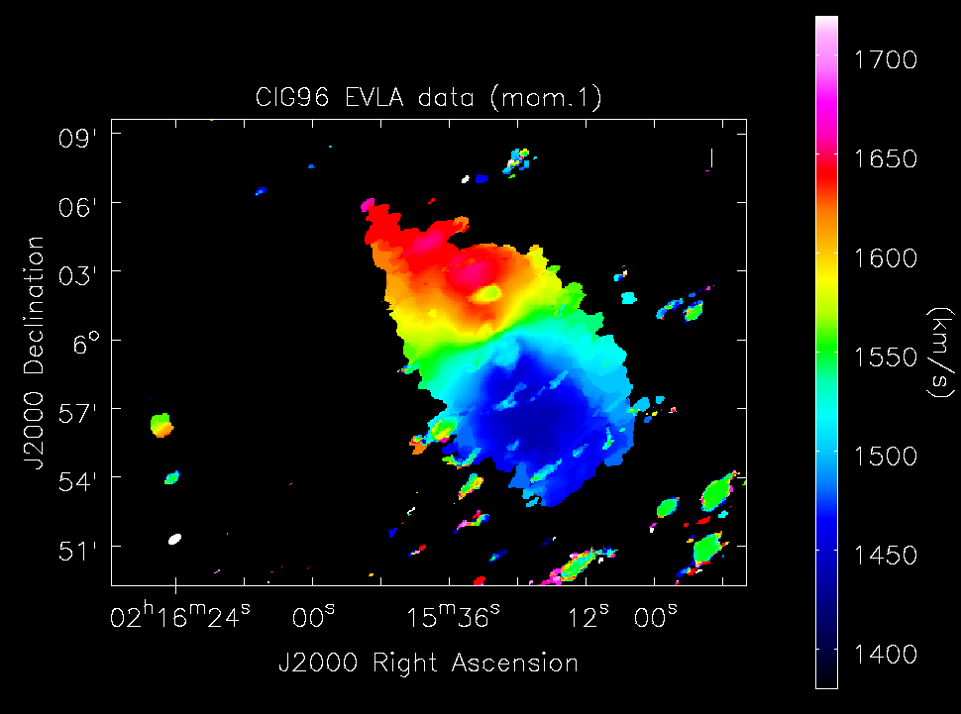
faint features
CIG96
EVLA data: 10h x C + 2h x D
Mean velocity map
(moment 1)
companion
5 MM
80 kpc
regular mean velocity display

Slide 24
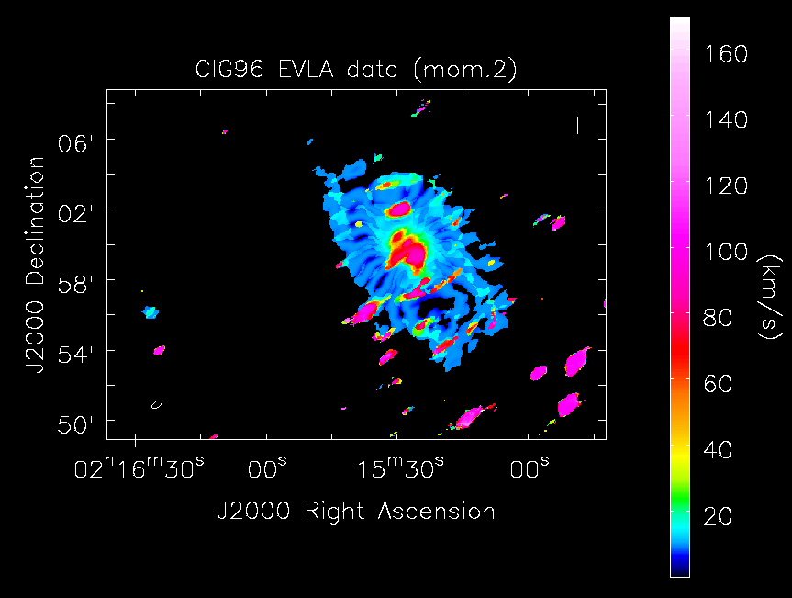
faint features
CIG96
EVLA data: 10h x C + 2h x D
Velocity dispersion map
(moment 2)
low dispersion
sidelobes

Slide 25
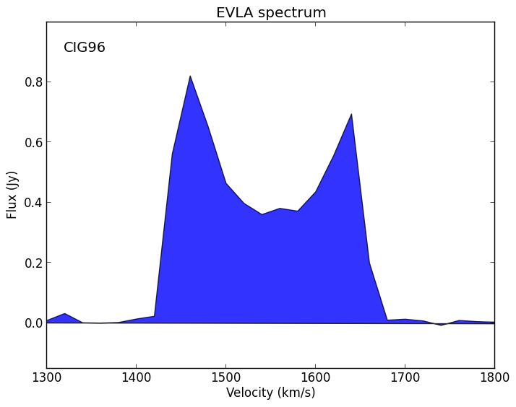
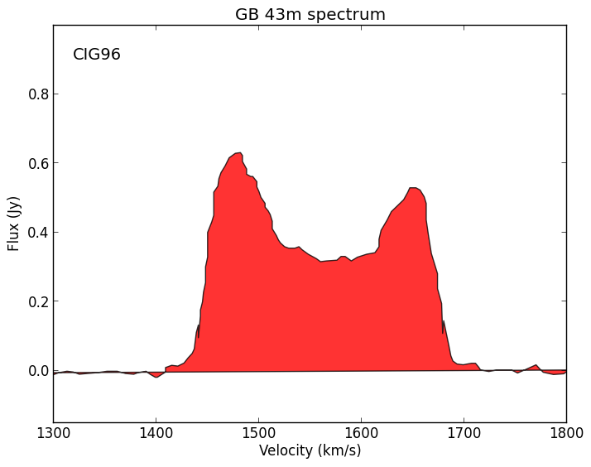
faint features
CIG96
Spectrum and total integrated flux
S_{1.4GHz-EVLA} = 126.82 Jy km/s
S_{1.4GHz-GB} = 102.96 Jy km/s
Haynes+ 98
Other S_{1.4GHz} literature values ~ 80 - 116 Jy km/s

Slide 26
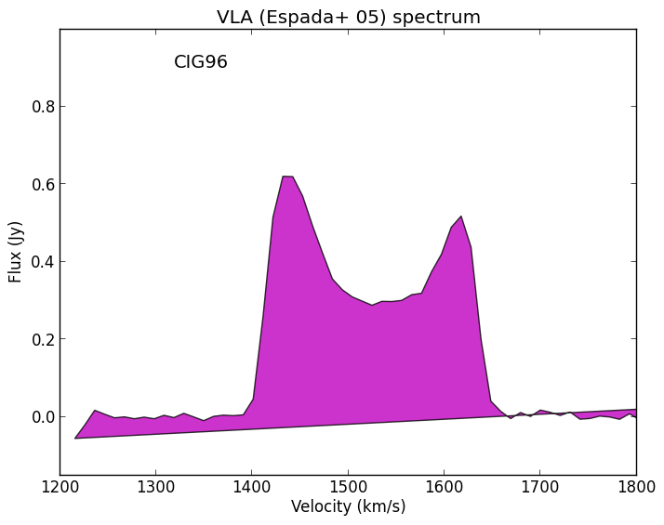
faint features
CIG96
Spectrum and total integrated flux
S_{1.4GHz-EVLA} = 126.82 Jy km/s
S_{1.4GHz-VLA} = 100.3 Jy km/s
Espada+ 05
Haynes+ 98
Other S_{1.4GHz} literature values ~ 80 - 116 Jy km/s

Slide 27
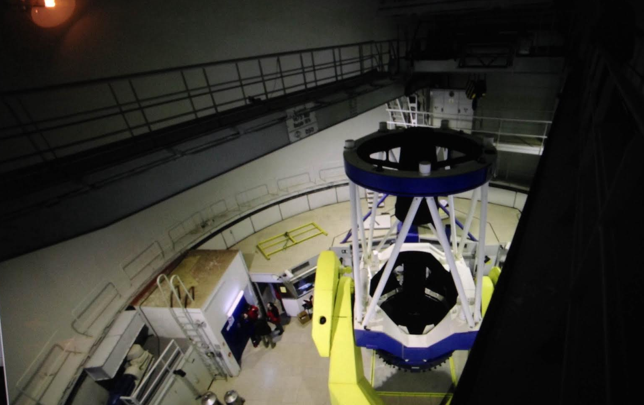
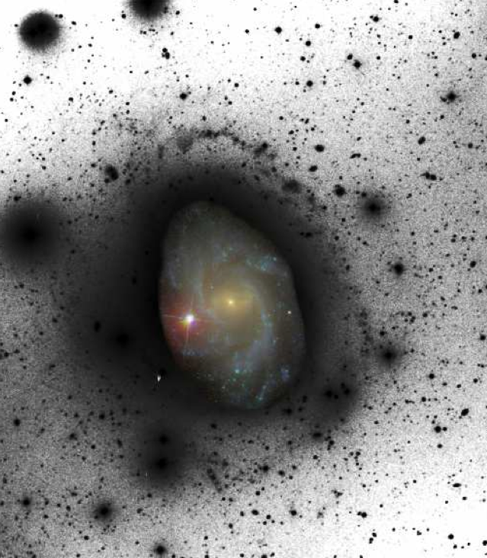
faint features
CIG96
Deep optical data
Deep HI data
faintest emission at 26.9 mag/arcsec² (r_{SDSS})
T_{on source} = 3.8h

Slide 28
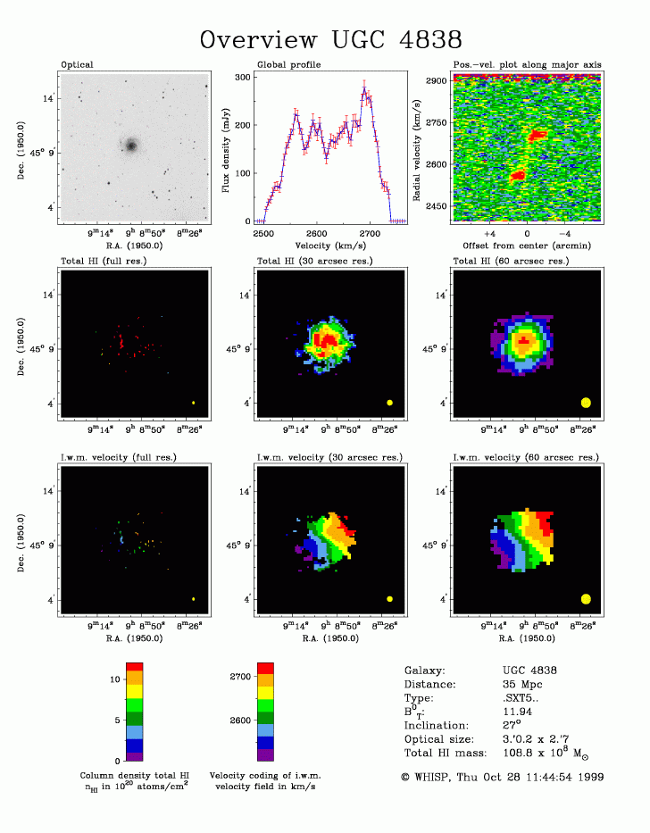
future work
CIG96
CIG314
CIG604
CIG1019
… 15+ CIG galaxies
WHISP + own EVLA, optical data

Slide 29
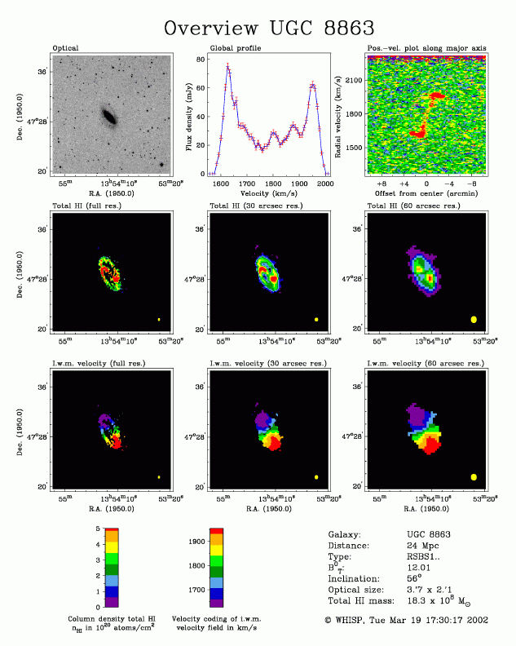
future work
CIG96
CIG314
CIG604
CIG1019
… 15+ CIG galaxies
WHISP + own EVLA, optical data

Slide 30
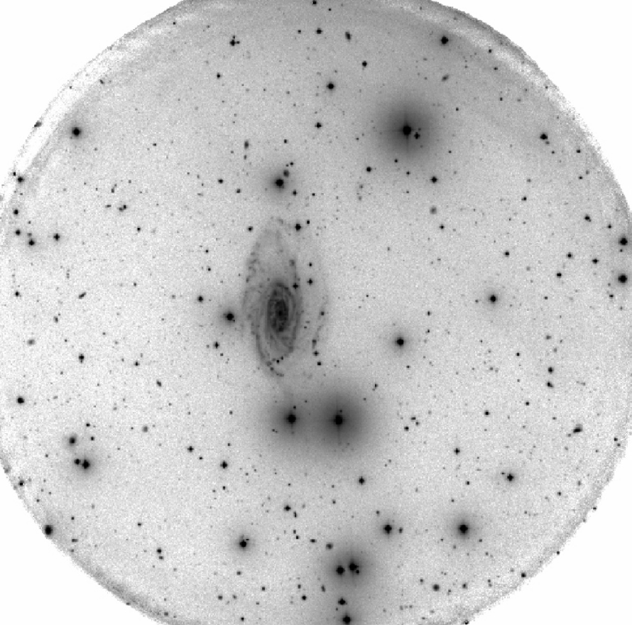
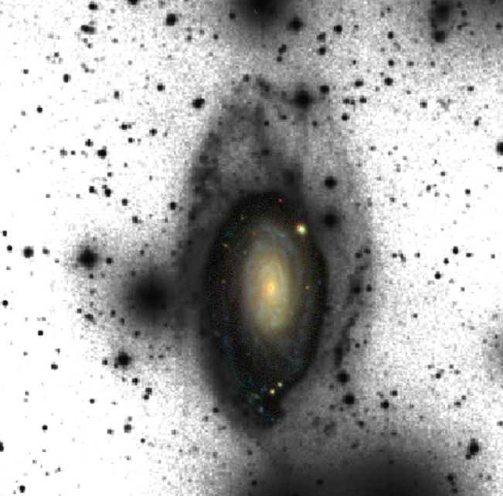
future work
CIG96
CIG314
CIG604
CIG1019
… 15+ CIG galaxies
own EVLA, optical data

Slide 31
summary
benefit: isolated galaxies can help us understand individual galactic evolution in high detail
limits: AMIGA works with one of the most restrictive isolation criteria upon one of the biggest samples of isolated galaxies
faint features: existent even in isolated galaxies, source?
how: deep radiointerferometric and optical data to explore the outskirts and look for tails, bridges, and other faint features
Thank you!

Slide 32
The environment of CIG96
{
Faint features in isolated galaxies
Thank you!
Pablo Ramírez Moreta (PhD student at IAA-CSIC)
Advisors: Lourdes Verdes Montenegro (IAA-CSIC)
Stéphane Leon (ESO/JAO)
ESO Santiago 7nov2014

Slide 33
morphologies
Type | %
E, E/S0 | 6%
S0, S0a | 9%
Sa - Sab | 4%
Sb - Sc | 65%
Scd - Im | 16%
Sulentic+ 06
Fernández-Lorenzo+ 12

Slide 34
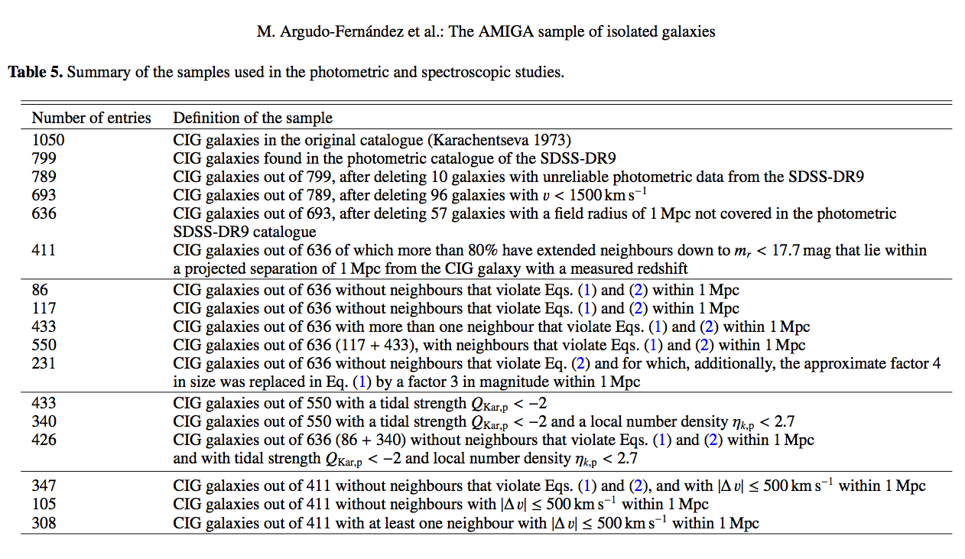
subsamples of the CIG
Argudo-Fernández+ 13

Slide 35
outline
motivation
project description
isolation
faint features, CIG96
future work

